Slide 1
Waterkers AI
Project Experience

Slide 2
Inhoud
Opdracht
Dataset
Training
Testen/evalueren
Deployment
Dashboard
Visualisatie
Conclusie

Slide 3
Opdracht

Slide 4
Dataset

Slide 5

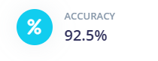
Training
Edge Impulse
MobileNetV2 (160x160 0.35)

Slide 6
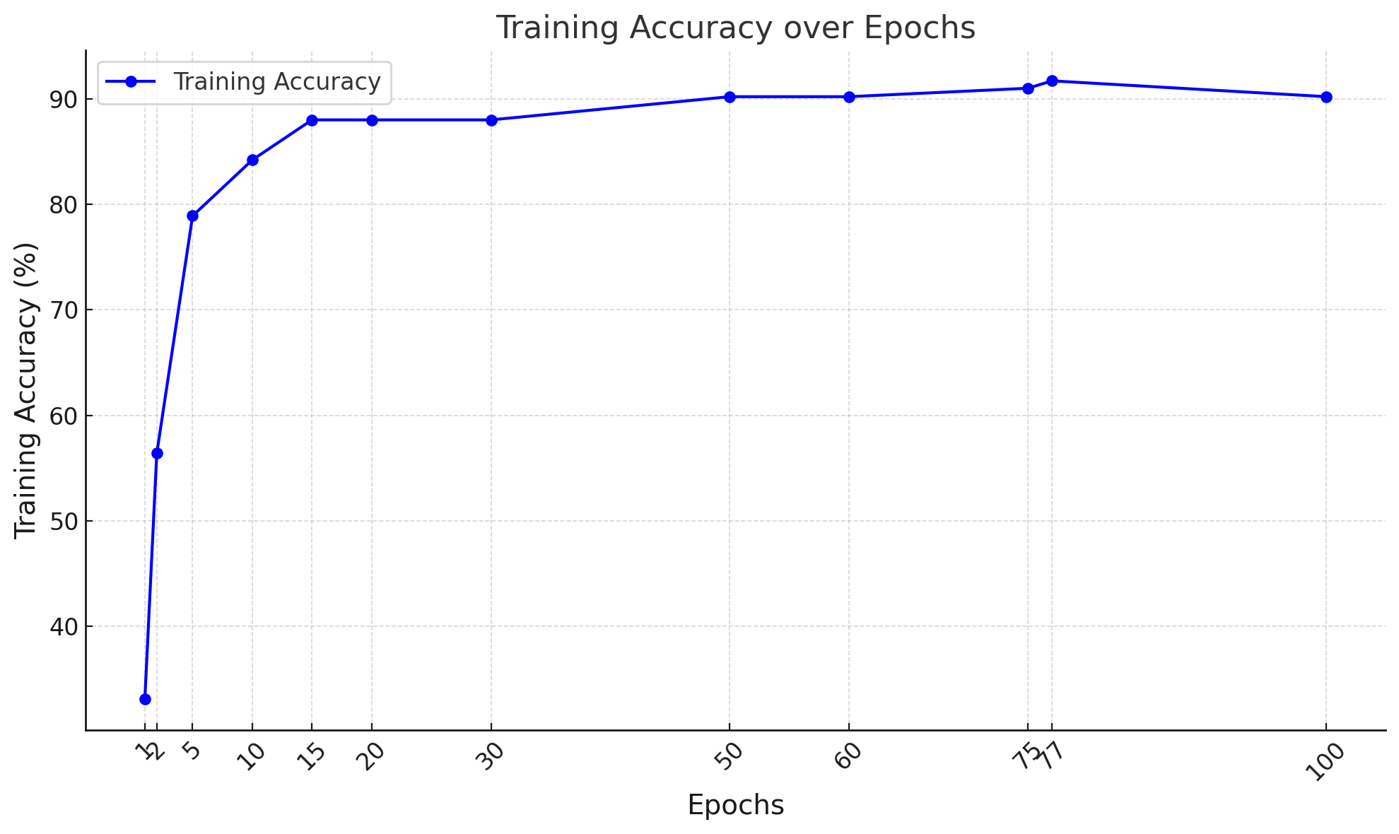
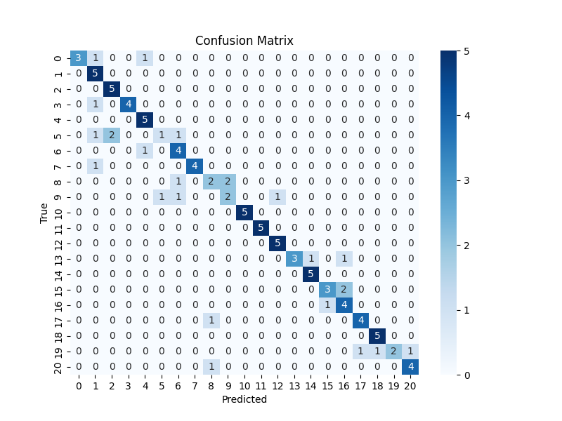
Testen/evalueren

Slide 7
Deployment

Slide 8
Dashboard

Slide 9
Visualisatie

Slide 10
Conclusie

